Slide 1
COMPUTER ORGANIZATION AND ARCHITECTURE (IT-206)
SUBMITTED BY : --- SUBMITTED TO :---
VARUN KUMAR (2K19-IT-140) Ms. Ruchi Holker
YASHIT KUMAR (2K19-IT-149)

Slide 2
MULTIPLICATION ALGORITHM

Slide 3
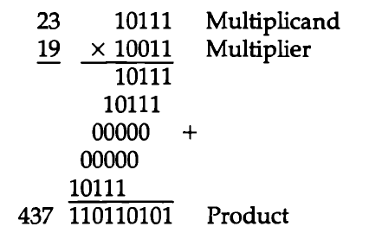
OBJECTIVE
Multiplication of two fixed point binary numbers in signed magnitude representation is done with paper and pencil by process of successive shifts and add operations.

Slide 4
